Slide 1
Creating a New User in Partners Online
** For adding functionality to an existing user’s account, please skip slides 5-9

Slide 2
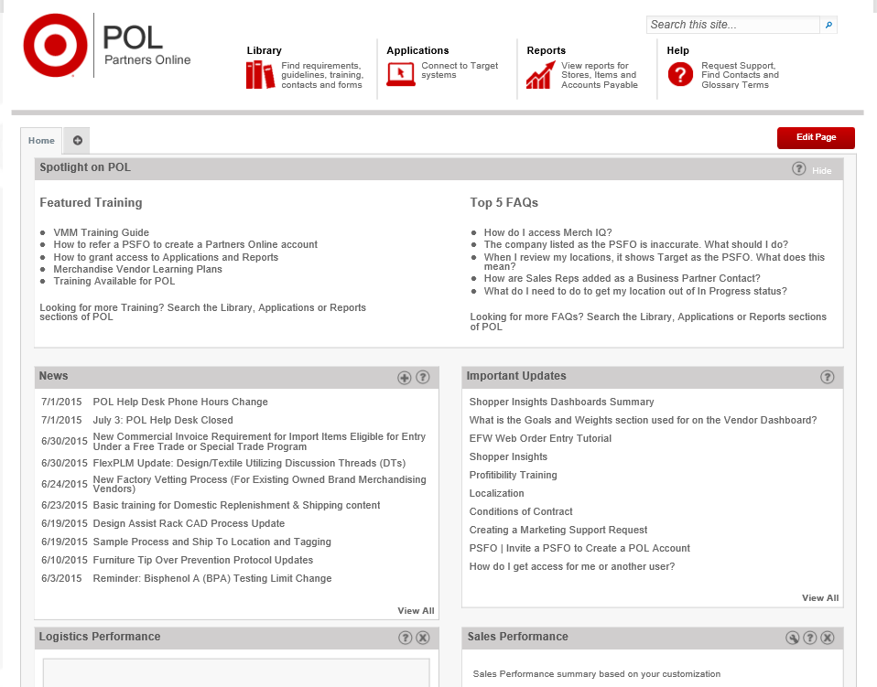
Click on the “Applications” tab at the top of your home page.

Slide 3
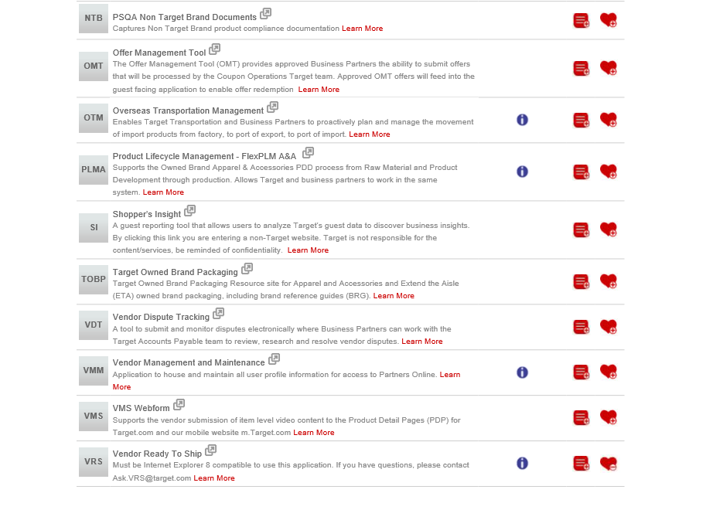
Scroll down to VMM

Slide 4
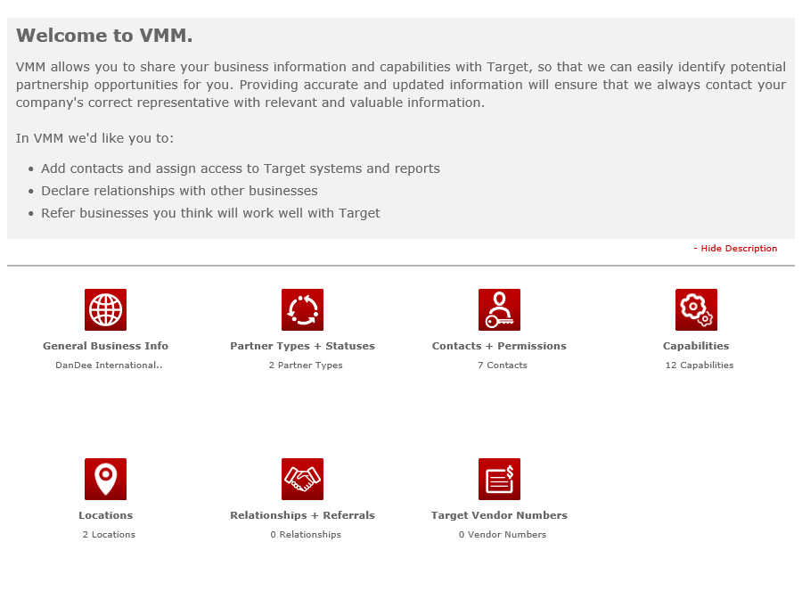
Select Contacts + Permissions

Slide 5
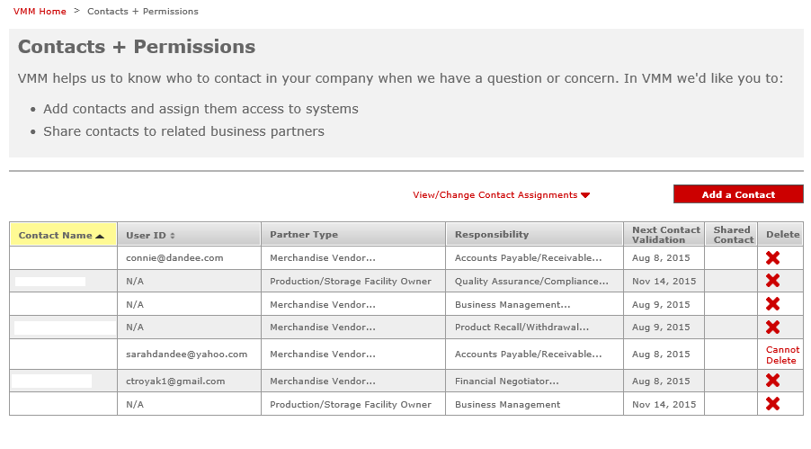
Click “add a contact”

Slide 6
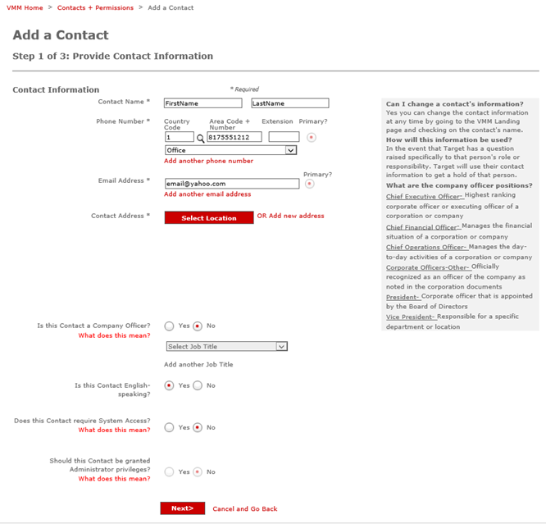
Fill in the contact information as instructed.

Slide 7
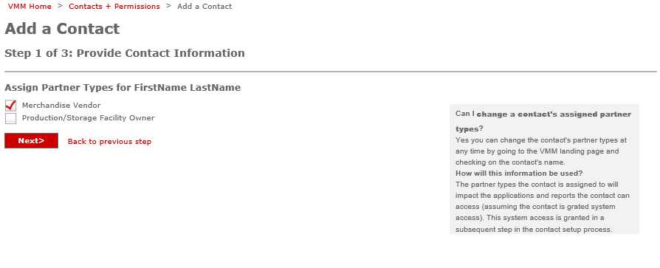
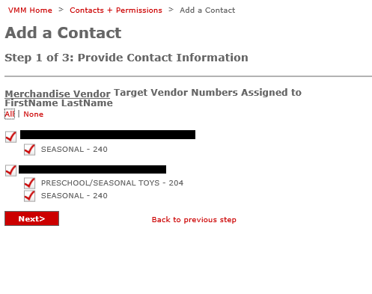
Select “Merchandise Vendor”
Select “all”

Slide 8
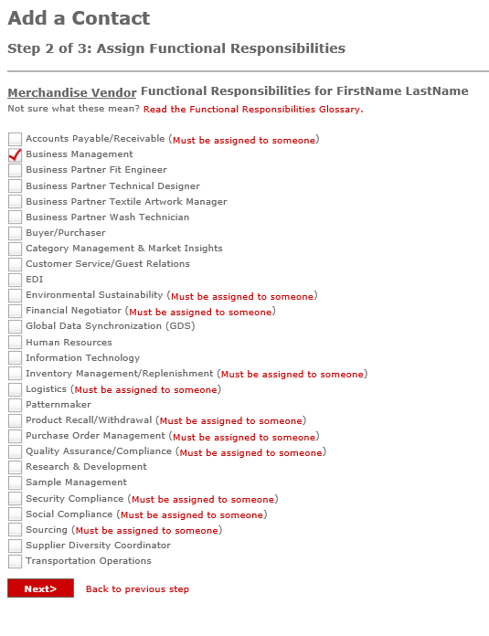
Assign responsibility of “Business Management”

Slide 9
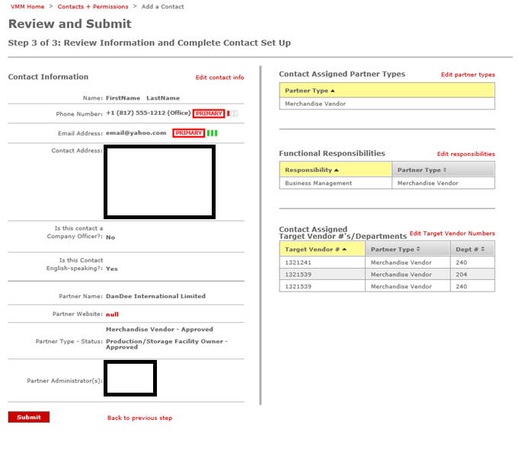
Review your information and click “submit”

Slide 10
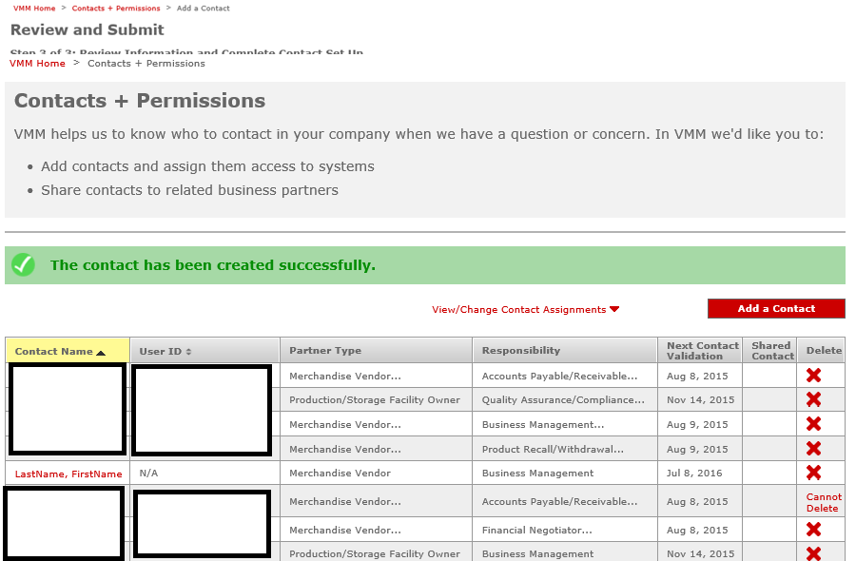
You should now see a message saying “The contact has been created successfully.
From here, click on the contact you just created.
** If looking to add functionality to an existing user, select the user you wish to edit.

Slide 11
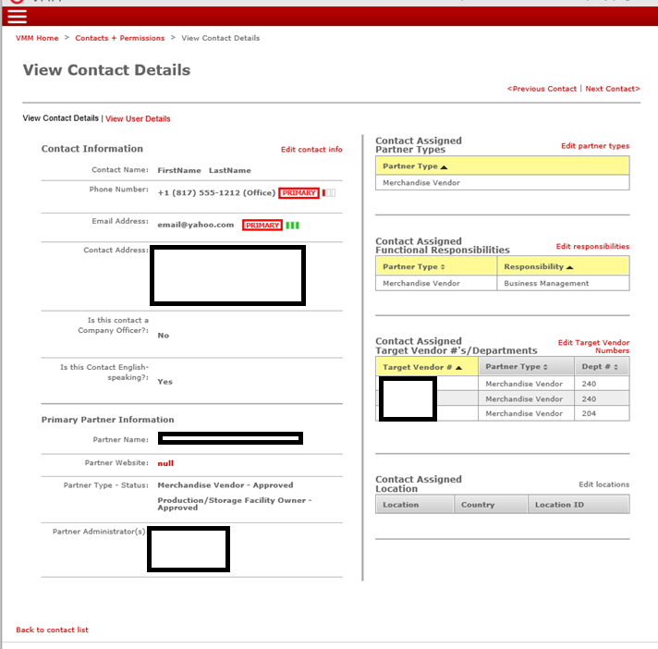
Click “view user details”

Slide 12
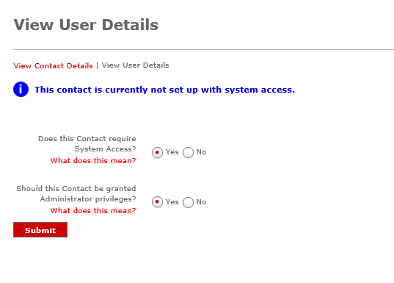
** Skip this step if working with an existing user.
Target does not automatically give new users access to any reporting or applications.
The next steps will ensure the new user has access to PO reports, Sales reports, Item Maintenance, etc.
Change both radio buttons to “yes” and click submit.

Slide 13
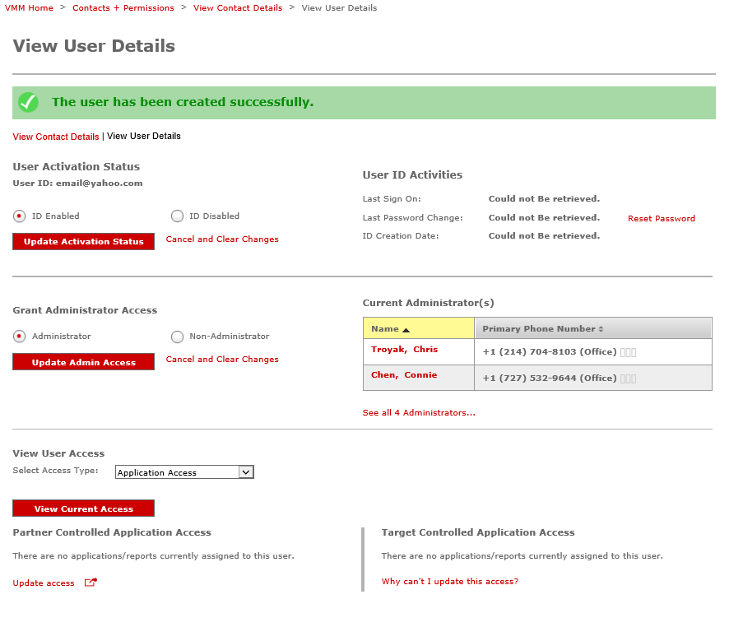
On the next page, click “update access”.
This should open a new browser window.

Slide 14
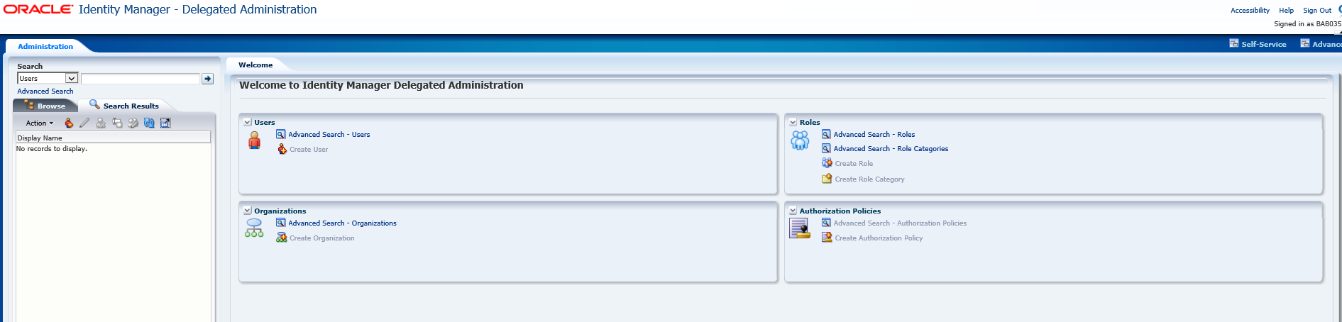
In the new window, click “advanced search – users” to find the contact you just created.

Slide 15
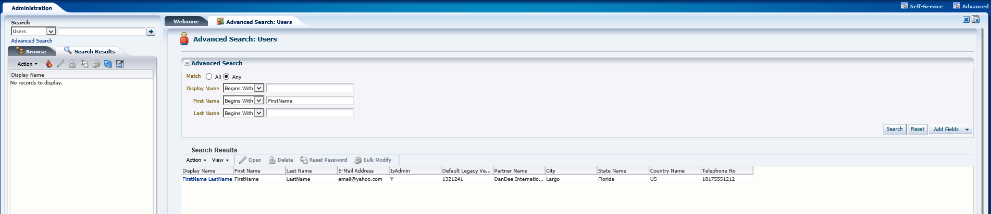
Type in either the first or last name (exactly as you set it up) and click “search”. This should bring up the contact you are working with.
Click on that contact.

Slide 16
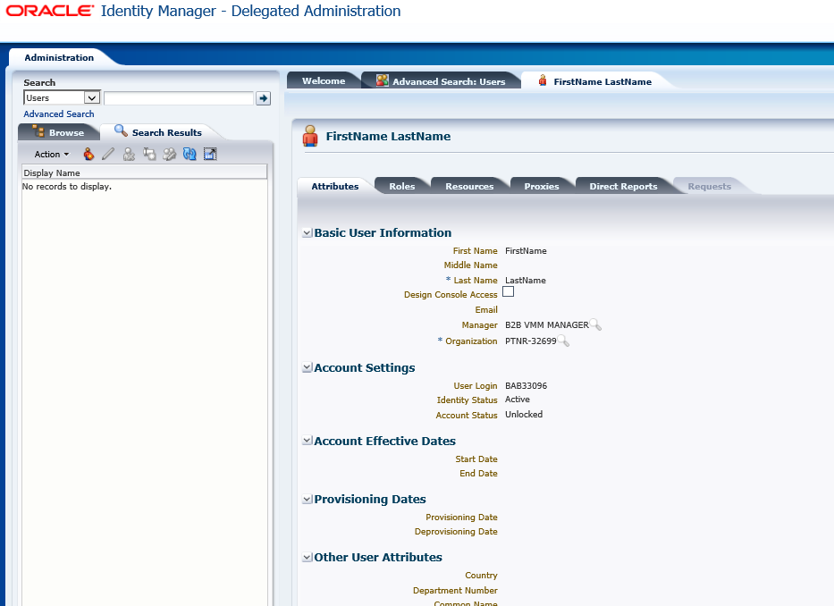
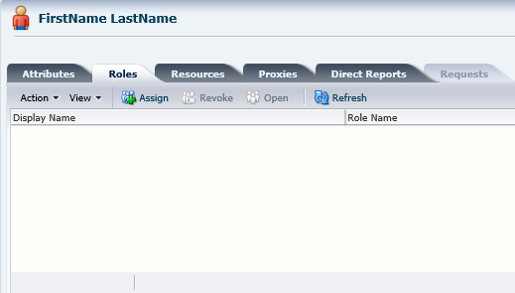
Click on the “roles” tab, then “assign”.

Slide 17
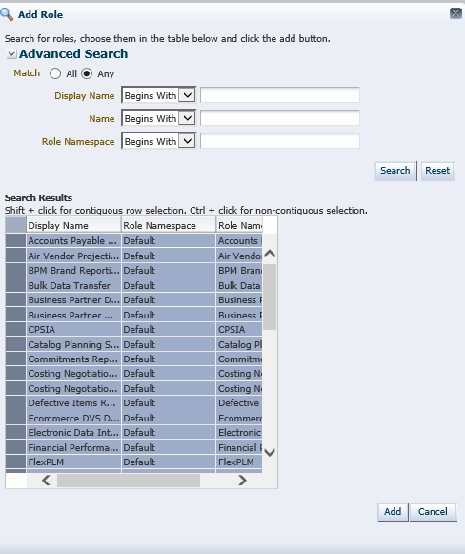
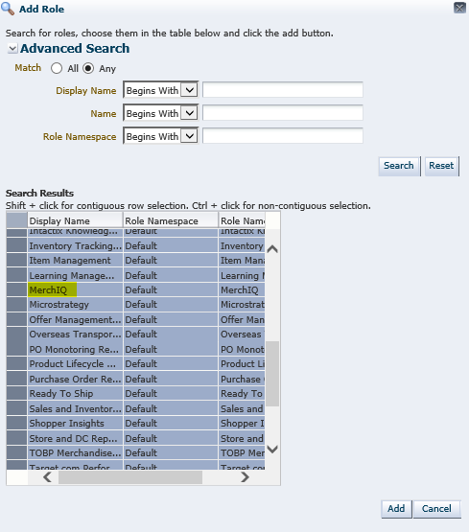
If looking to add a specific application to an existing user, scroll down to that application, select it, then click “add”
Leave all fields blank and click “search” to bring up all reports/applications
Click the box in the upper left-hand corner to select all options, then “add”

Slide 18
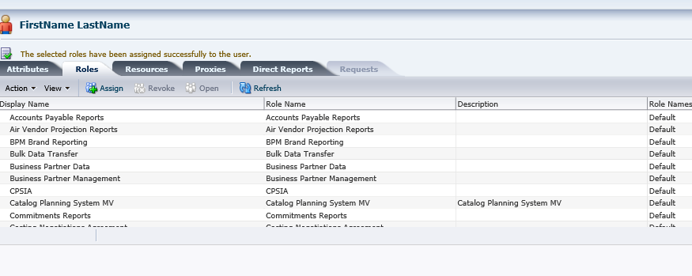
The next screen should show your user with all reports/applications added.
The setup process is now complete and you can exit the browser window.

